Slide 1



Memory-Awareness: Boosting NVM Energy Efficiency and Endurance
Saeed Kargar¹, Faisal Nawab²
1
2
Notes:
Hello Everyone. My name is Saeed Kargar and I am a Ph.D. student from University of California Santa Cruz and Today I'm going to present Memory-awareness:....... This is a joint work with Faisal Nawab my advisor from UCI.

Slide 2
Outline
Background on NVM
Motivation
Hamming Tree Design
Evaluation Results
Conclusion
Notes:
Well, let's start with a brief overview of NVMs, their characteristics, strengths, and limitations.

Slide 3
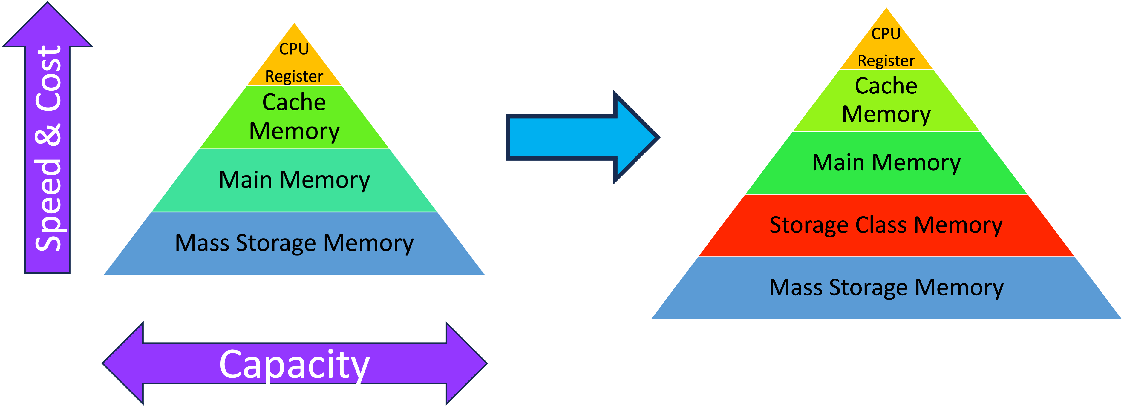
Non-Volatile Memory
byte-addressable
Persistent
High scalable
zero standby power
high cell densities
high bandwidth, and so on.
Notes:
Well, non-volatile memories are fast byte-addressable and persistent memory technologies that are changing the computer system's landscapes. They are like DRAMs, but retain their contents after power loss, and they are high scalable. They have zero standby power, high cell densities, high bandwidth, and so on. By emerging these technologies now, we have a new level in storage hierarchy named storage-class memory, which is not only byte-addressable and fast like DRAMs, but also non-volatile like disks.

Slide 4
Limitations
Parameters | DRAM | NVM
Non-volatility | No | Yes
Read time (ns) | ~ 10 | ~ 20 - 50
Write time (ns) | ~ 10 | ~ 10 - 100
Endurance (write/bit) | 10¹⁸ | ~ 10⁶ – 10⁸
Energy per bit access (r/w) | ~ 2 pJ | ~ 20 – 100 pJ
Static power | Yes | No
Notes:
However, Like any other technologies, these new technologies have their own limitations that need to be considered before utilizing them in our systems. First of all, unlike read operations, the write operations demand a significant amount of current and power, as we can see here.
Furthermore, compared to their counterparts, such as DRAMs, they have limited lifetime.

Slide 5
Limitations
In Hamming Tree, we focus on energy consumption and write endurance of PCMs.
Parameters | DRAM | NVM
Non-volatility | No | Yes
Read time (ns) | ~ 10 | ~ 20 - 50
Write time (ns) | ~ 10 | ~ 10 - 100
Endurance (write/bit) | 10¹⁸ | ~ 10⁶ – 10⁸
Energy per bit access (r/w) | ~ 2 pJ | ~ 20 – 100 pJ
Static power | Yes | No
Notes:
In hamming tree, we focus on energy consumption and write endurance of PCMs.

Slide 6
Outline
Background on NVM/Phase Change Memory
Motivation
Hamming Tree Design
Evaluation Results
Conclusion

Slide 7
Key Challenge:
How to reduce write operations on PCM
Notes:
So here, the main challenge is how to reduce write operations on PCMs. Well, there are different methods and solutions to deal with this problem, which can be divided into the following categories. And the last category, which is called bit-fillet reduction, the methods try to read the old content of the memory location before writing the new content and only writing the bits that are different.

Slide 8
State-of-the-Art:
How to reduce write operations on PCM
  Reducing write amplification
    designing specialized data structures that require fewer writes
Notes:
The methods in the first category focus on reducing write amplification through designing specialized data structures that require fewer writes.

Slide 9
State-of-the-Art:
How to reduce write operations on PCM
  Reducing write amplification
    designing specialized data structures that require fewer writes
  Wear-leveling
    distributing the writes evenly across the memory blocks of PCM device so that no hot area reaches its maximum lifespan
Notes:
In the second category, which is called wear-leveling, they try to distribute the writes evenly across the memory blocks of PCM devices so that no hot area reaches its maximum lifespan.

Slide 10
State-of-the-Art:
How to reduce write operations on PCM
  Reducing write amplification
    designing specialized data structures that require fewer writes
  Wear-leveling
    distributing the writes evenly across the memory blocks of PCM device so that no hot area reaches its maximum lifespan
  Bit flip reduction
    reading the old content of the memory location before writing the new content and only writing the bits that are different
Notes:
And in the last category, the old content of the memory is read before writing the new content and only the bits are written that are different.

Slide 11
Memory awareness
The problem with the previous methods is that they assume nothing about the data distribution of the real-world data
Selecting memory locations based on bit-wise similarity among items can reduce the number of bit flips significantly.
Notes:
Well, the problem with the previous methods is that they assume nothing about the data distribution of the real-world data, and by selecting memory locations based on bit-wise similarity among items, we can reduce the number of bit-fillets significantly.

Slide 12
Memory awareness
New opportunity: selecting memory locations based on bit-wise similarity → reduce the number of bit flips significantly.

Slide 13
Memory awareness
1 | 1 | 0 | 1 | 0 | 0 | 0 | 1
1 | 1 | 0 | 1 | 0 | 0 | 0 | 1
0 | 1 | 0 | 1 | 0 | 1 | 0 | 1
0 | 1 | 1 | 1 | 1 | 0 | 1 | 1
0 | 0 | 1 | 0 | 1 | 1 | 1 | 0
Segment 1
Segment 2
Segment 3
Segment 4
PCM
Consumed
Energy
NVM
Wear out
1
Segment
1
Segment
Notes:
For example, we can see that writing the same data on different memory locations caused differently in terms of the number of bit flips.

Slide 14
Memory awareness
1 | 1 | 0 | 1 | 0 | 0 | 0 | 1
0 | 1 | 0 | 1 | 0 | 1 | 0 | 1
0 | 1 | 1 | 1 | 1 | 0 | 1 | 1
0 | 0 | 1 | 0 | 1 | 1 | 1 | 0
Segment 1
1 | 1 | 0 | 1 | 0 | 0 | 0 | 1
Segment 2
Segment 3
Segment 4
PCM
Consumed
Energy
NVM
Wear out
1
2
Segment
1
2
Segment

Slide 15
Memory awareness
1 | 1 | 0 | 1 | 0 | 0 | 0 | 1
0 | 1 | 0 | 1 | 0 | 1 | 0 | 1
0 | 1 | 1 | 1 | 1 | 0 | 1 | 1
0 | 0 | 1 | 0 | 1 | 1 | 1 | 0
Segment 1
Segment 2
1 | 1 | 0 | 1 | 0 | 0 | 0 | 1
Segment 3
Segment 4
PCM
Consumed
Energy
NVM
Wear out
1
2
3
1
2
3
Segment

Slide 16
Memory awareness
1 | 1 | 0 | 1 | 0 | 0 | 0 | 1
0 | 1 | 0 | 1 | 0 | 1 | 0 | 1
0 | 1 | 1 | 1 | 1 | 0 | 1 | 1
0 | 0 | 1 | 0 | 1 | 1 | 1 | 0
Segment 1
Segment 2
Segment 3
1 | 1 | 0 | 1 | 0 | 0 | 0 | 1
Segment 4
PCM
Consumed
Energy
NVM
Wear out
1
2
3
4
1
2
3
4
Segment

Slide 17
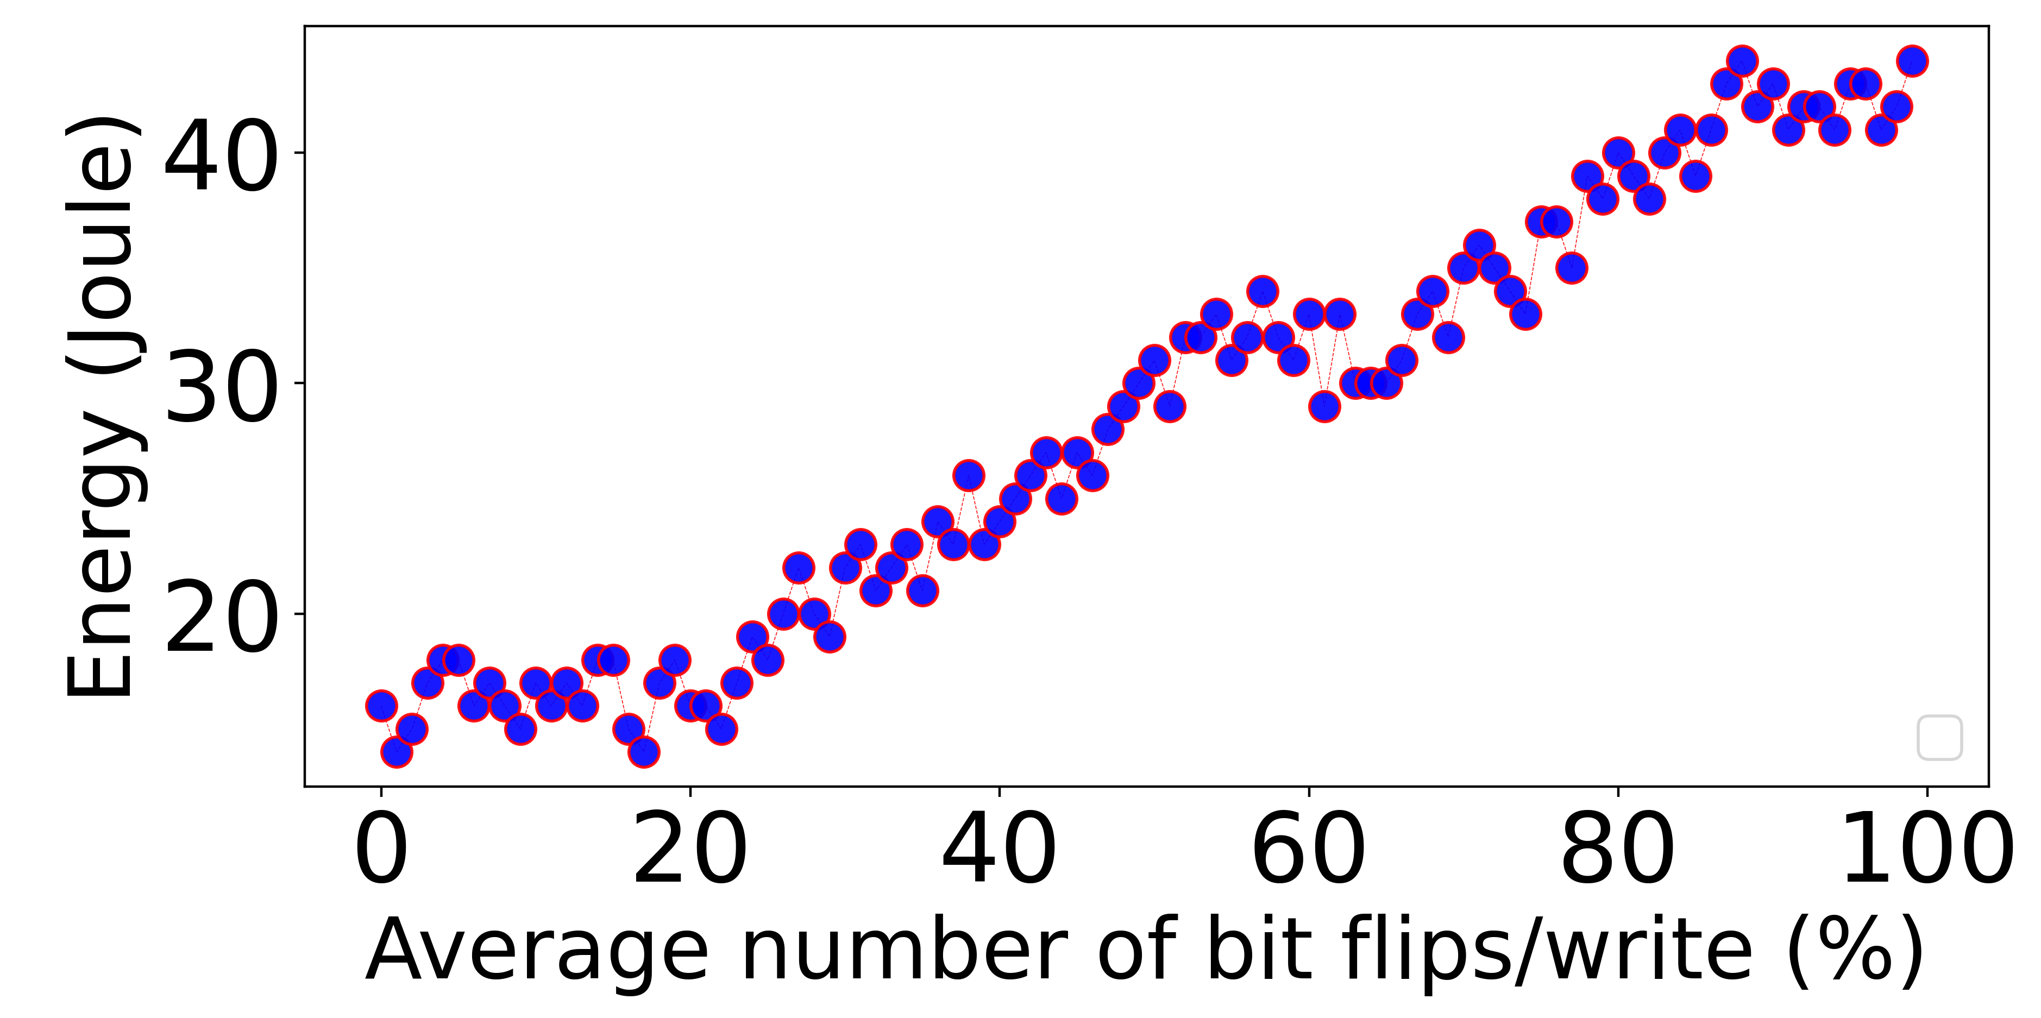
Memory awareness
Notes:
To see the effect of the number of bit flips in right operations on the energy consumption of the system, we conducted an experiment, and as we can see in this experiment, there is a positive correlation between these two variables.

Slide 18
Outline
Background on NVM/Phase Change Memory
Motivation
Hamming Tree Design
Evaluation Results
Conclusion

Slide 19
Hamming Tree: System model
Storage management layer
a library that can be used by existing applications and data storage systems.
Notes:
Hamming Tree is implemented on the storage management layer, which can be seen as a library used by existing applications and data storage systems.

Slide 20
Hamming Tree: A Software-level Memory Aware Technique
Available/free
Memory segments
(e.g., 4KB)
PCM
Notes:
Well, let's explain our method with an example. Suppose that we have a PCM device.

Slide 21
Hamming Tree: A Software-level Memory Aware Technique
Available/free
Memory segments
(e.g., 4KB)
10100100101010001111010100101010101010010101
10001010101010111110101010101010101010010101
PCM
Notes:
We divide its available memory locations into some equal size parts that we call memory segments. Each memory segment already contains some old data that will be replaced or overwritten by incoming write requests.

Slide 22
Hamming Tree: A Software-level Memory Aware Technique
Available/free
Memory segments
(e.g., 4KB)
A map of free memory segments
10100100101010001111010100101010101010010101
10001010101010111110101010101010101010010101
PCM
Notes:
In Hamming tree, we utilize an indexing data structure to index free memory locations according to their contents' hamming distance.

Slide 23






Hamming Tree: A Software-level Memory Aware Technique
PCM
Notes:
In fact, Hamming tree clusters similar memory locations near each other on the tree.

Slide 24
Hamming Tree: A Software-level Memory Aware Technique
New data
10100100101010001111010100101010101010010101
PCM
Notes:
So, when a new data needs to be written on PCM,

Slide 25
Hamming Tree: A Software-level Memory Aware Technique
New data
10100100101010001111010100101010101010010101
Hamming Tree
PCM
Notes:
it goes through Hamming tree to find a memory location that matches its density of zeros and ones,

Slide 26
Hamming Tree: A Software-level Memory Aware Technique
New data
10100100101010001111010100101010101010010101
Hamming Tree
PCM
Notes:
which means that the selected memory locations bitwise content is similar to the write content. So, Hamming tree uses an underlying indexing structure such as B-Tree or RB-Tree to map available or free memory locations of PCM.

Slide 27
Hamming Tree: Key Idea
Hamming Tree uses a hamming-distance-based comparison function to compare data items: measuring the density of 1’s and 0’s between the left half and the right half of the data items.
data 1
data 2
11111110 00100000
00011001 11101010
Notes:
However, the key idea here is that Hamming tree uses a Hamming distance-based comparison function to compare data items, which means it measures the density of ones and zeros between the left half and the right half of the data items.
For example, when we compare data one and data two using this function,

Slide 28
Hamming Tree: Key Idea
Hamming Tree uses a hamming-distance-based comparison function to compare data items: measuring the density of 1’s and 0’s between the left half and the right half of the data items.
data 1
data 2
11111110 00100000
00011001 11101010
7
1
2
5
Notes:
it's divided into two parts and then this function measures the density of ones and zeros between the left half and the right half of the data item. And returns the difference of the number of one bits in the right segment to the number of ones in the left segments, as we can see here.

Slide 29
Hamming Tree: Key Idea
Hamming Tree uses a hamming-distance-based comparison function to compare data items: measuring the density of 1’s and 0’s between the left half and the right half of the data items.
data 1
data 2
11111110 00100000
00011001 11101010
7
1
2
5
Diff = 1 – 7 = -6
Diff = 5 – 2 = 3
Notes:
And the bigger item is selected based on this comparison.

Slide 30
Hamming Tree: Key Idea
Hamming Tree uses a hamming-distance-based comparison function to compare data items: measuring the density of 1’s and 0’s between the left half and the right half of the data items.
data 1
<
data 2
11111110 00100000
00011001 11101010
7
1
2
5
Diff = 1 – 7 = -6
Diff = 5 – 2 = 3
Notes:
So, in this example, data 2 is bigger than data 1.

Slide 31
Hamming Tree: Key Idea
Hamming Tree uses a hamming-distance-based comparison function to compare data items: measuring the density of 1’s and 0’s between the left half and the right half of the data items.
data 1
<
data 2
data 3
11111110 00100000
00011001 11101010
00101000 11001110
7
1
2
5
Diff = 1 – 7 = -6
Diff = 5 – 2 = 3
Notes:
However, when the differences are the same,

Slide 32
Hamming Tree: Key Idea
Hamming Tree uses a hamming-distance-based comparison function to compare data items: measuring the density of 1’s and 0’s between the left half and the right half of the data items.
data 1
<
data 2
data 3
11111110 00100000
00011001 11101010
00101000 11001110
7
1
2
5
2
5
Diff = 1 – 7 = -6
Diff = 5 – 2 = 3
=
Diff = 5 – 2 = 3
Notes:
as we can see here for data 2 and data 3

Slide 33
Hamming Tree: Key Idea
Hamming Tree uses a hamming-distance-based comparison function to compare data items: measuring the density of 1’s and 0’s between the left half and the right half of the data items.
data 1
<
data 2
data 3
11111110 00100000
000110011110 1010
001010001100 1110
3
2
2
3
7
1
Diff = 1 – 7 = -6
Notes:
the function is called recursively on the part of the data item with higher density of ones until it finds the bigger item,

Slide 34
Hamming Tree: Key Idea
Hamming Tree uses a hamming-distance-based comparison function to compare data items: measuring the density of 1’s and 0’s between the left half and the right half of the data items.
data 1
<
data 2
<
data 3
11111110 00100000
000110011110 1010
001010001100 1110
3
2
2
3
7
1
Diff = 1 – 7 = -6
Diff = 2 – 3 = -1
Diff = 3 – 2 = 1
Notes:
which, in this case, is data 3, because it is bigger.

Slide 35
Hamming Tree
Hamming Tree orders free memory locations according to the hamming distance of their contents.
DRAM
0xdd00
0xdd04
0xdd0c
0xdd14
0xdd10
0xdd08
0xdd18
PCM
Notes:
So hamming tree orders free memory locations according to the hamming distance of their contents.

Slide 36
Outline
Background on NVM/Phase Change Memory
Motivation
Hamming Tree Design
Evaluation Results
Conclusion

Slide 37
Evaluation Methodology
Compared techniques
  NVM-friendly K/V stores and data structures (focus on reducing write amplification)
  Hardware-based bit flip optimization methods (focus on reducing the number of bit flips)
Workloads and Datasets
  Synthetic workloads
    YCSB
  Real-world datasets
    Amazon Access Samples (textual dataset)
    3D Road Network Data Set (textual dataset)
    PubMed (textual dataset)
    MNIST, Fashion-MNIST, and ImageNet (Image datasets)
    Urban tracker and traffic surveillance video datasets (Video datasets)
Notes:
In this paper, we compared our method with different state-of-the-art techniques, such as MVM-friendly key-value stores and data structures that focus on reducing write amplification, and also hardware-based bitflip optimization methods that focus on reducing the number of bit flips. We also used various datasets and workloads from text data to image data and video datasets.

Slide 38
Overall Hamming Tree Benefits
By plugging Hamming Tree, the system consumes up to 67.8% less energy.
Notes:
Well, in the first experiment, we tested the effect of plugging hamming tree on different key-value data stores and data structures.

Slide 39
Overall Hamming Tree Benefits
By plugging Hamming Tree, the system consumes up to 67.8% less energy.
Notes:
And we observed that by plugging hamming tree, the system consumes up to 67% less energy.

Slide 40
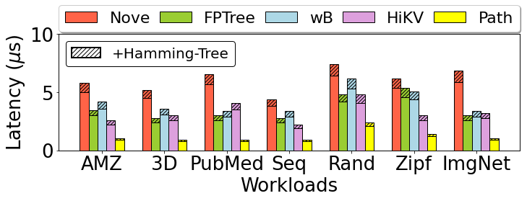
Hamming Tree: Overhead
Up to 18% overhead on latency after augmenting with Hamming Tree.
Notes:
We also observed that hamming-tree incur up to 18% overhead on latency

Slide 41
Hamming Tree: Overhead
Up to 18% overhead on latency after augmenting with Hamming Tree.
Notes:
when it's augmented with other data structures and key value data stores.

Slide 42
Conclusion
Memory awareness is an opportunity and Hamming Tree is our solution to validate this idea:
  software-level
  energy efficiency
  write endurance
Results (Energy efficiency):
Up to 67.8% when it is combined with other K/V stores and data structures
Up to 60% compared to the existing hardware-based techniques and wear-leveling methods
Notes:
In Conclusio, Hamming-Tree is a software-level approach to improve energy efficiency and write endurance of PCMs. It uses an indexing data structure to map memory locations based on the Hamming distance of their content. We also propose a compaction strategy to save memory space even more. And our method addresses the swapping nature of underlying memory controllers. We showed that by using a hamming tree, we can improve the energy efficiency and write endurance of PCMs up to 67.8% when it's combined with other key value stores and data structures and up to 60% compared to the existing hardware-based techniques and wave leveling methods.

Slide 43

Thank you! Questions?
Saeed Kargar
skargar@ucsc.edu
Faisal Nawab
nawabf@uci.edu
Notes:
Thank

