Slide 1
RackBlox: A Software-Defined Rack-Scale Storage
System with Network-Storage Co-Design
Benjamin Reidys
Yuqi Xue Daixuan Li Bharat Sukhwani*
Wen-mei Hwu Deming Chen Sameh Asaad* Jian Huang
*

Slide 2
Software-Defined Infrastructure is Increasingly Popular
Clients
Software-Defined
Networking
Redefine
management policies
Top of Rack (ToR) Switch
…
Adopted in major data centers
Storage Server
Storage Server
Software-Defined Storage
Systems Platform Research Group at UIUC

Slide 3
What is Software-Defined Networking?
Control Plane
I/O
Scheduling
Congestion Control
Data Plane
L2/L3 Routing
Data
Cache
Network Statistics
Programmable Switch
Customized packet format
Customized packet processing
Flexible traffic management
Systems Platform Research Group at UIUC

Slide 4
What is Software-Defined Storage?
Allow software to manage storage chips
Storage Server
Systems Platform Research Group at UIUC

Slide 5
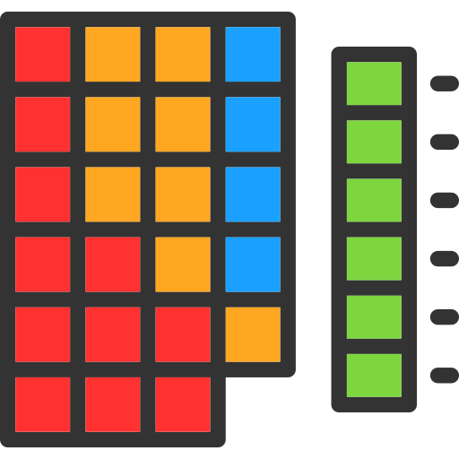
Background on Solid-State Drives
Garbage collection for out-of-place updates
Wear leveling distributes writes across flash blocks
Allow software to manage storage chips
Increasing performance
Decreasing Cost
Control Plane
I/O Scheduling
Garbage
Collection
Wear
Leveling
ECC
Bad Block Management
Address Translation
Storage Server
Data Plane
Read
Write
Erase
Systems Platform Research Group at UIUC

Slide 6
What is Software-Defined Flash?
Allow software to manage storage chips
Improved resource utilization
Predictable storage performance
Control Plane
I/O Scheduling
Garbage
Collection
Wear
Leveling
ECC
Bad Block Management
Address Translation
Storage Server
Data Plane
Read
Write
Erase
Systems Platform Research Group at UIUC

Slide 7
SDN/SDF are Managed Separately Today
Control Plane
I/O
Scheduling
Congestion Control
Data Plane
L2/L3 Routing
Data
Cache
Network Statistics
Software-Defined Networking
Software-Defined Flash
Control Plane
I/O Scheduling
Garbage
Collection
Wear
Leveling
ECC
Bad Block Management
Address Translation
Storage Server
Data Plane
Read
Write
Erase
Systems Platform Research Group at UIUC

Slide 8
Research Problem: Lack of Coordination between SDN/SDF
Software-Defined Networking
Control Plane
I/O
Scheduling
Congestion Control
Data Plane
Conflicting policies!
L2/L3 Routing
Data
Cache
Network Statistics
Control Plane
Redundant effort!
I/O Scheduling
Garbage
Collection
Wear
Leveling
ECC
Bad Block Management
Address Translation
Data Plane
Missed opportunities for rack-scale optimization!
Read
Write
Erase
Software-Defined Flash
Systems Platform Research Group at UIUC

Slide 9
Research Problem: Lack of Coordination between SDN/SDF
Does not leverage existing data replicas during GC!
Switch is the central hub for all I/O requests!
…
SSDs wear out an uneven rate!
Different SSDs may have different write traffic!
Data is replicated by default!
Systems Platform Research Group at UIUC

Slide 10
Research Problem: Lack of Coordination between SDN/SDF
Software-Defined Networking
Control Plane
I/O
Scheduling
Congestion Control
Data Plane
Conflicting policies!
L2/L3 Routing
Data
Cache
Network Statistics
SDN and SDF should coordinate!
Control Plane
Redundant effort!
I/O Scheduling
Garbage
Collection
Wear
Leveling
ECC
Bad Block Management
Address Translation
Data Plane
Missed opportunities for rack-scale optimization!
Read
Write
Erase
Software-Defined Flash
Systems Platform Research Group at UIUC

Slide 11
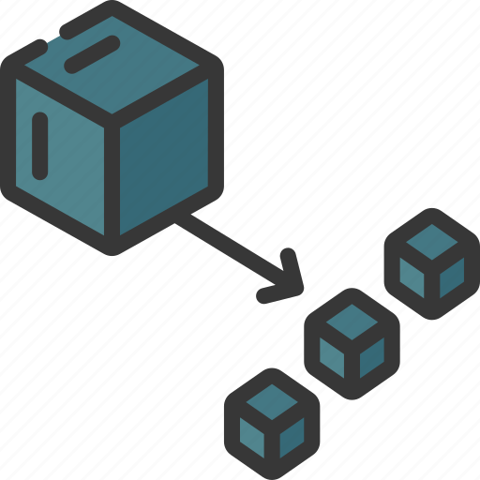
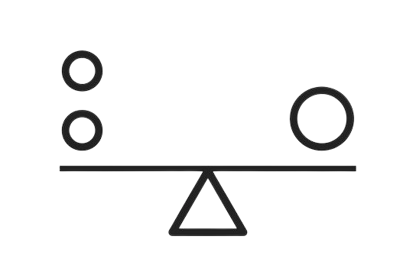
RackBlox: A Software-Defined Rack-Scale Storage System
Control Plane
Coordinated I/O
Scheduling
Coord. Garbage
Collection
Global Wear
Leveling
Decouple storage management
I/O
Scheduling
Congestion Control
Data Plane
L2/L3 Routing
Data
Cache
Network Statistics
Enable coordinated I/O scheduling
RackBlox
Control Plane
I/O Scheduling
Local Wear Leveling
Enable coordinated garbage collection
Local I/O
Scheduling
Local Garbage Collection
Wear
Leveling
Garbage
Collection
ECC
Bad Block Management
Address Translation
Data Plane
Enable rack-scale wear leveling
Read
Write
Erase
Systems Platform Research Group at UIUC

Slide 12
Enabling SDN/SDF Codesign is Challenging
Storage Management
SDN
SDF
How to decouple the storage management
Limited hardware resources in the switch
Ensure flexibility and
ease-of-use
Systems Platform Research Group at UIUC

Slide 13
Decoupling the Storage Management Across SDN/SDF
Storage Management in SDN
Storage Functions
vSSD_ID | GC Status | Replica vSSD_ID
vSSD1 | 1 | vSSD12
vSSD2 | 0 | vSSD20
I/O Scheduling
Benefit from coordination
Garbage
Collection
vSSD_ID | GC Status | Server IP
vSSD1 | 1 | 10.0.0.16
vSSD2 | 0 | 10.0.0.20
Wear
Leveling
Address Translation
Storage Management in SDF
Bad Block Management
vSSD #1
vSSD #2
State retained in switch?
ECC
…
vSSD #3
Flash Channels
13
Systems Platform Research Group at UIUC

Slide 14
State Communication Between SDN/SDF
Requires no hardware changes!
Customized packet for RackBlox
ETH | IP | TCP/UDP | OP | vSSD_ID | Latency | Payload
OP code | Operation Name | Description
000 | create_vssd | Register new vSSD in switch
001 | del_vssd | Remove vSSD from switch
010 | write | Client write
011 | read | Client read
100 | gc_op | Packet to update GC in switch
Systems Platform Research Group at UIUC

Slide 15
Enabling Coordinated I/O Scheduling
Request Delay
Network Delay
Storage Delay
Request #1
Storage Delay
Network Delay
Storage Delay
Request #2
Storage Delay
SLO Latency
$${Prio}_{sched}$$
=
Request #1
$${Net}_{time}$$
In-Network Telemetry
Request #2
+
$${Storage}_{time}$$
Storage Queuing Delay
I/O Request
+
I/O Request
$${Predict}_{time}$$
Sliding Window Predictor
Storage Queue
Systems Platform Research Group at UIUC

Slide 16
Enabling Coordinated Garbage Collection
Storage Request
A
Check switch tables
vSSD_ID | GC Status
vSSD | 1
Replica | 0
VSSD_ID | Server IP
vSSD | 10.0.0.16
Replica | 10.0.0.20
B
Redirect request
GC can add significant storage delay!
vSSD
Replica
Systems Platform Research Group at UIUC

Slide 17
Enabling Coordinated Garbage Collection
Storage Requests
B
Check switch tables
C
No, GC delayed!
vSSD_ID | GC Status
vSSD | 1
Replica | 0
vSSD_ID | GC Status
vSSD | 1
Replica | 1
vSSD_ID | GC Status
vSSD | 0
Replica | 0
vSSD_ID | GC Status
vSSD | 0
Replica | 1
VSSD_ID | Server IP
vSSD | 10.0.0.16
Replica | 10.0.0.20
GC finished
A
Can I do GC now?
C
Yes, GC executes!
Replicas may execute GC simultaneously
vSSD
Replica
Systems Platform Research Group at UIUC

Slide 18
Enabling Coordinated Garbage Collection
Storage Requests
C
Update switch tables
vSSD_ID | GC Status
vSSD | 0
Replica | 0
vSSD_ID | GC Status
vSSD | 1
Replica | 0
VSSD_ID | Server IP
vSSD | 10.0.0.16
Replica | 10.0.0.20
B
Notify Switch
Request redirection
Delayed GC
Leverage idle storage cycles for GC
vSSD
Replica
Background GC
A
Predict idle time
Systems Platform Research Group at UIUC

Slide 19
Enabling Rack-Scale Wear Leveling
Global Wear Leveling
Swap SSDs within servers every 16 days
Local Wear Leveling
Local Wear Leveling
Increased cost
vSSD
vSSD
vSSD
vSSD
vSSD
vSSD
vSSD
vSSD
…
…
Increased management complexity
Swap SSDs across servers every 8 weeks
Workload instances have diverse write intensity!
Systems Platform Research Group at UIUC

Slide 20
Programmable SSDs
1 TB
16 Channels
16 KB/page
70 MB/s per channel
Programmable Switch
RackBlox Implementation
Intel Tofino Switch
Workloads
YCSB
TPC-H
TPC-C
AuctionMark

Slide 21
Improving End-To-End I/O Performance
Networking!
Storage!
RackBlox reduces tail latency by up to 4.8x!
Systems Platform Research Group at UIUC

Slide 22
RackBlox Supports Different Storage Schedulers
Coordinated I/O Scheduling always outperforms incoordination!
Systems Platform Research Group at UIUC

Slide 23
Network/Storage Codesign
RackBlox Summary
Improves End-to-End I/O Performance
Ensures Rack-Scale Wear-Balance

Slide 24
Thank You!
Benjamin Reidys
Yuqi Xue Daixuan Li Bharat Sukhwani
Wen-mei Hwu Deming Chen Sameh Asaad Jian Huang
Systems Platform Research Group

Slide 25
Network/Storage Codesign
RackBlox Summary
Improves End-to-End I/O Performance
Ensures Rack-Scale Wear-Balance

Slide 26
Enabling Coordinated I/O Scheduling
Request Delay
Network Delay
Storage Delay
Request #1
Storage Delay
Network Delay
Storage Delay
Request #2
Storage Delay
SLO Latency
$${Prio}_{sched}$$
=
$${Net}_{time}$$
In-Network Telemetry
I/O Request
Request #1
+
Request #2
I/O Request
$${Storage}_{time}$$
Storage Queuing Delay
Storage Queue
+
$${Predict}_{time}$$
Sliding Window Predictor
Systems Platform Research Group at UIUC
Notes:
Now that we have fully discussed how to decouple and update the storage state between the SDN and SDF, I will present the coordination that this network/storage co-design enables, starting with coordinated I/O scheduling. Requests may arrive at storage servers with different network delays caused by differences in network scheduling or other network factors. Without coordination, the storage server first execute request #2 and delay request #1, which may violate its SLO. Instead, we could prioritize the request #1 in the storage while realizing that the low network delay for request #2 allows us to relax its storage scheduling. To achieve this, we schedule requests locally in a coordinated fashion using the three components that correspond to end-to-end I/O performance: the incoming network delay, the storage delay, and the outgoing network delay. We compute the incoming network delay as the sum of per hop latencies in the switches using In-Network Telemetry available in programmable switches. We estimate the storage delay based on when the request enters the storage queue. We estimate the outgoing network delay through a simple sliding window algorithm using the recent incoming network latencies. Now consider the previous example, request #2 arrives with a low measured and predicted network delay so it is enqueued into the storage queue with low priority. Request #1 arrives with a high network delay and receives higher scheduling priority. The requests are then processed in a coordinated fashion to improve end-to-end performance.

Slide 27
Improving End-To-End I/O Performance
RackBlox reduces tail latency by up to 4.8x!
Systems Platform Research Group at UIUC
Notes:
We breakdown the performance of RackBlox and compare against (1) VDC which provides software based token-bucket rate limiting per I/O Flow enforced for both network and storage at the end-hosts. Next, we compare RackBlox with only I/O scheduling enabled. Finally, we show the performance of RackBlox. We see that coordinated I/O scheduling can outperform and achieves 1.4x speedup on average. However, with higher write rates, we have more intensive GC and therefore coordinated GC is necessary, resulting in nearly 5x speedup.
**See if we can re-plot this in excel in some wonderfully clever way.

Slide 28
Improving End-To-End I/O Performance
RackBlox reduces tail latency by up to 4.8x!
Systems Platform Research Group at UIUC
Notes:
We breakdown the performance of RackBlox and compare against (1) VDC which provides software based token-bucket rate limiting per I/O Flow enforced for both network and storage at the end-hosts. Next, we compare RackBlox with only I/O scheduling enabled. Finally, we show the performance of RackBlox. We see that coordinated I/O scheduling can outperform and achieves 1.4x speedup on average. However, with higher write rates, we have more intensive GC and therefore coordinated GC is necessary, resulting in nearly 5x speedup.
**see if we can use the breakdown figure here.

Slide 29
Enabling Rack-Scale Wear Leveling
Global Wear Leveling
Local Wear Leveling
Local Wear Leveling
Swap SSDs within servers every 16 days
Increased cost
…
…
Increased management complexity
Swap SSDs across servers every 8 weeks
Cloud Services
Each rack runs many heterogeneous workloads!
Systems Platform Research Group at UIUC
Notes:
Finally, let us discuss how we enable coordinated wear-leveling. By default, SSDs maximize their lifetime by evenly distributing erases across the underlying flash blocks. However, workload heterogeneity can cause wear-imbalance not just within the blocks of an SSD, but also between SSDs within a server or between SSDs across servers. This can lead to early SSD failure which increases cost and management complexity. To address this, we propose a two-level hierarchical wear balancing mechanism. Within each server we introduce a local wear balancer that swaps SSDs within the server following a relaxed wear level scheme proposed in our prior work, FlashBlox. An SSD is swapped block by block atomically by pausing the operations for the chosen blocks, reading them into memory, writing them to their new locations, updating the mapping tables, and serving the paused requests. We can guarantee near optimal lifetime by only swapping every 16 days on average. At server level, network bandwidth can cause significant overhead to swapping so we relax the swapping frequency to every 8 weeks. The local and global wear-balancers work together to keep the rack wear-balanced.
**Want to fix the workloads, show the vSSDs above and different workloads..

Slide 30
Enabling Coordinated I/O Scheduling
Time
Network Delay
Storage Delay
Request #1
Storage Delay
Request #2
Network Delay
Storage Delay
SLO Latency
In-Network Telemetry (INT)
Storage Queuing Delay
Sliding Window Predictor
Systems Platform Research Group at UIUC
Notes:
I will first present how we enable coordinated I/O scheduling. Requests may arrive at storage servers with different network delays caused by differences in network scheduling or other network factors. Without coordination, the storage server may prioritize the request with lower network delay without realizing that delaying the other request may violate the SLO. Instead, we could prioritize the delayed request in the storage while realizing that we the low network delay gives us slack time to delay the other request. Through coordination, we can achieve the SLO for both requests. To achieve this, we schedule requests locally in a coordinated fashion using three components. The network delay before arriving at the server, which is computed as the sum of per hop latencies in the switches using In-Network Telemetry. The storage delay, which we can estimate based on when the request enters the storage stack. And the network delay after leaving the server, which we estimate with a simple, yet effective sliding window algorithm that predicts the return latency using the recent network state. Together, this enables the local storage scheduling to incorporate the network state and appropriately prioritize to achieve predictable end-to-end performance.
**Switch to SLO
**one by one in example
**add scheduling/queue diagram.
**Switch formula to something better looking

Slide 31
Decoupling the Storage Management Across SDN/SDF
Storage Management in SDN
Storage Functions
vSSD_ID | GC Status | Replica vSSD_ID
vSSD1 | 1 | vSSD12
vSSD2 | 0 | vSSD20
I/O Scheduling
Benefits from coordination?
Garbage
Collection
vSSD_ID | GC Status | Server IP
vSSD1 | 1 | 10.0.0.16
vSSD2 | 0 | 10.0.0.20
Wear
Leveling
Address Translation
Storage Management in SDF
Bad Block Management
vSSD #1
vSSD #2
State retained in switch?
ECC
…
vSSD #3
Flash Channels
31
Systems Platform Research Group at UIUC
Notes:
Due to the hardware constraints of SDN, we want to keep as much of the local storage management in the SDF. Accordingly, we use the “virtual SSD” or vSSD abstraction, that we proposed in our prior works FlashBlox and BlockFlex, to manage the local SDF. A vSSD groups together a collection of underlying flash channels and virtualizes them. This enables RackBlox to keep the essential functions for local storage management in the server. When decoupling the storage state for coordination between SDN and SDF, we consider two factors. First, whether integrating the storage function into SDN will benefit from coordination or not. Functions such as bad block management, ECC, and address translation do not benefit, so they remain exclusively in the SDF. For the I/O scheduling, GC, and wear-leveling, we determine if coordination requires using switch memory. We identify that only coordinating GC requires switch memory as I/O scheduling can use the packet and wear-leveling happens infrequently. Therefore, we store two tables in the switch to support coordinating GC. The replica table, which maps the vSSD to its current GC status and replica and the destination table that maps the vSSD to its home server. These tables consume at most 1.3 MB of the 10s of MBs of on-chip switch memory.
This one should flow more
We have sdf -> which has all of these storage function -> ecc in device -> vssd encapsulates -> for the remaining that benefit from coord, we check if should be retained in switch, etc… Think this through very carefully.

Slide 32
Research Problem: Lack of Coordination between SDN/SDF
Software-Defined Networking
Control Plane
I/O
Scheduling
Congestion Control
Data Plane
Conflicting policies!
L2/L3 Routing
Data
Cache
Network Statistics
SDN and SDF should coordinate!
Control Plane
Redundant effort!
I/O Scheduling
Garbage
Collection
Wear
Leveling
ECC
Bad Block Management
Address Translation
Data Plane
Read
Write
Erase
Missed opportunities for rack-scale optimization!
Software-Defined Flash
Systems Platform Research Group at UIUC
Notes:
First, we see that both SDN and SDF have I/O scheduling policies. Unfortunately, the scheduling decisions for packets in the network could conflict with the scheduling decisions for those requests in the storage stack. For one, these conflicting scheduling decisions can lead to unpredictable end-to-end performance. Additionally, separately optimizing the SDN and SDF for end-to-end performance results in redundant effort and additional complexity. We also see that certain storage functions could benefit from a global view of the entire rack. For example, wear-leveling, which helps extend SSD lifetime, is currently performed within individual SSDs, but could be extended to the entire rack. Additionally, garbage collection could be coordinated across data replicas in a rack to avoid its performance interference. Without coordination, we miss out on significant opportunities for optimization and leads us to the conclusion that SDN and SDF should coordinate.
**zoom out for gc + wl
**split
**can also preempt sw in that slide

Slide 33
Enabling Coordinated Garbage Collection
Storage Request
vSSD_ID | GC Status
vSSD | 1
Replica | 0
vSSD_ID | GC Status
vSSD | 1
Replica | 1
vSSD_ID | GC Status
vSSD | 0
Replica | 0
vSSD_ID | GC Status
vSSD | 0
Replica | 1
VSSD_ID | Server IP
vSSD | 10.0.0.16
Replica | 10.0.0.20
Background GC
Request GC
Request redirection
Delayed GC
vSSD
Replica
Background GC
Systems Platform Research Group at UIUC
Notes:
TODO: Need some form of lingering text after the animation disappears -> probably want to split this across slides.
Now that we have empowered the local storage to consider the network state in scheduling, we want to allow the network to consider the storage state. Here we leverage the fact that rack-scale storage deploys at least two replicas so one rack another replica to a different rack by default. In this way, we can leverage the data replicas to redirect requests that would see significant delay due to ongoing GC. For incoming read requests, we first check the GC status bit in the table. If the bit is set, we check the replica to ensure it is not performing GC and redirect the request. However, as writes are issued to all replicas, it is possible for both vSSDs to be performing GC and redirection would not reduce tail latency. Therefore, we enable delaying GC in the switch. vSSDs will request to perform GC earlier than usual, giving the switch an opportunity to delay one replica while the other finishes its GC. Later, if the replica is not performing GC, the request is granted. In this fashion we can minimize the overlap in GC and maximize the chance that one data replica is available to serve requests. Finally, we also enable background GC by opportunistically leverage idle cycles with a simple prediction mechanism using the exponential weighted average of prior idle time. With high accuracy, we predict how long we can perform GC and notify the switch directly so it can redirect requests.

Slide 34
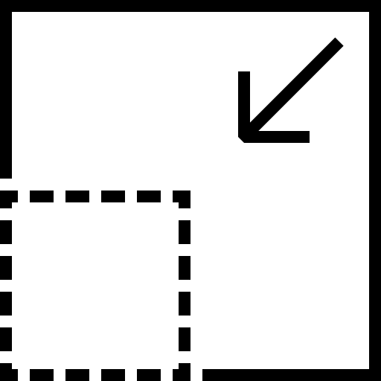
Decoupling the Storage Management
Storage Management in SDN
vSSD_ID | GC Status | Replica vSSD_ID
vSSD1 | 1 | vSSD12
vSSD2 | 0 | vSSD20
Benefits from coordination?
vSSD_ID | GC Status | Server IP
vSSD1 | 1 | 10.0.0.16
vSSD2 | 0 | 10.0.0.20
Storage Management in SDF
VSSD #1
VSSD #2
…
Consumes minimal resources?
Storage Server
VSSD #3
Flash Channels
34
Systems Platform Research Group at UIUC
Notes:
TODO change dramatically to the column and guide through the questions->which benefit->do they consume minimal resources?
In order to decouple the storage management between the SDN and SDF, we first need to share the storage state. Due to the hardware constraints, we want to keep as much of the storage management in the local servers as possible and reduce the burden on SDN. Accordingly, we consider two factors. First, whether integrating an SDF function into SDN will benefit from the coordination or not. Second, if yes, the integration should consume minimum precious hardware resources in the switch. Accordingly, we use the “virtual SSD” or vSSD abstraction, that we proposed in our prior works FlashBlox and BlockFlex. A vSSD groups together a collection of underlying flash channels exposed in SDF and virtualizes them. This enables us to easily keep the storage functions with better performance when in the local storage such as bad block management, ECC, and address translation in the SDF. vSSDs can help achieve predictable performance as individual flash channels can be allocated to a specific vSSD, providing hardware isolation. In the switch, we store two tables to support the storage functions that benefit from coordination. The replica table, which maps the vSSD to its current GC status and replica and the destination table to map the vSSD to its home server. These allow the SDN to redirect requests and coordinate GC and consume only 1.3 MB of the 10s of MBs of on-chip switch memory.

Slide 35
What is Software-Defined Storage?
Storage software directly manages the internal operations of devices
Improved resource utilization
Predictable storage performance
Control Plane
I/O Scheduling
Garbage
Collection
Wear
Leveling
ECC
Bad Block Management
Address Translation
Storage Server
Data Plane
Read
Write
Erase
Systems Platform Research Group at UIUC
Notes:
TODO split into three slides with ssd background in the middle.
Due to the benefits of software-defined networking, software-defined storage was also developed. Software-defined storage enables data centers to unlock the potential of storage devices by enabling the software to directly interact with them and control their internal operations. One common example of software defined storage is software defined flash or SDF, which builds on top of solid-state drives (SSDs). In order to understand the details of software-defined flash, let me first introduce SSDs, which due to their high performance and decreasing cost, are being increasingly deployed in modern data centers. Each SSD also has a control plane and data plane. The control plane performs storage functions such as address translation, ECC, bad block management, etc. While the data plane executes the read/write/erase operations. Many of these storage functions are necessary due to the unique properties of the flash medium. Wear leveling, which distributes the erases evenly across the underlying flash blocks, is necessary due to the limited erase count before each flash block wears out and is unusable. Garbage collection periodically erases blocks to ensure free blocks are available for out-of-place updates because flash does not support overwrites. This must be done carefully as erase operations are expensive and can add orders of magnitude delay to storage operations. Software-defined flash opens the black box of the SSDs and allows the system to manage these functions. By exposing these functions to the upper-level system, SDF can achieve improved resource utilization and more predictable storage performance.

Slide 36
Modern Data Centers are Increasingly Software Defined
Clients
Software-Defined
Networking
Redefine
Management Policies
Top of Rack (ToR) Switch
…
Improved
Resource Efficiency
Storage Server
Storage Server
Software-Defined Storage
Systems Platform Research Group at UIUC
Notes:
TODO: better symbol for software defined + need to better describe why they are becoming popular.
Essential logical flow -> Increasingly becoming software defined-> defined as control plane + data plane which allows redefining management policies for improved resource efficiency-> Because of these benefits, we saw SDN developed and later, SDS->deployed in Google data centers, Alibaba, etc.
Modern data center infrastructure is increasingly software-defined where each component has a control plane that defines the policies and a data plane that executes them. By making infrastructure software-defined, we achieve two major benefits. First, we achieve the flexibility to redefine the policies of the control plane to quickly adapt to data center needs. Second, we can define customized policies that optimize resource efficiency.
Missing why.

Slide 37
Managing Data Center Storage at Rack-Scale
Clients
Software-Defined
Networking
Simplified
Resource Management
Top of Rack (ToR) Switch
…
Improved
Resource Utilization
Storage Server
Storage Server
Software-Defined Storage
COMPUTER SCIENCE
Systems Platform Research Group at UIUC
Notes:
In order to provide storage services, data centers manage storage at rack scale.

Slide 38
What is Software-Defined Networking?
Control Plane
I/O
Scheduling
Congestion Control
Data Plane
L2/L3 Routing
Data
Cache
Network Statistics
Software-Defined Networking
Software-Defined Storage
Control Plane
Address Translation
Garbage
Collection
Wear
Leveling
ECC
Bad Block Management
I/O
Scheduling
Programmable Switches
Customized Network Functions
Storage Server
Data Plane
Read
Write
Hardware Constraints
Erase
COMPUTER SCIENCE
Systems Platform Research Group at UIUC
Notes:
Data centers adopted software defined networking and software defined storage for the flexibility such as in scheduling and resource management. For networking, this is achieved…
Make new slide with new title: “SDN/SDF are managed separately”… makes sense on face.

Slide 39
Software-Defined Storage Infrastructure
Control Plane
I/O
Scheduling
Congestion Control
Data Plane
Empowered Storage Software
Improved Resource Efficiency
L2/L3 Routing
Data
Cache
Network Statistics
Software-Defined Networking
Software-Defined Storage
Control Plane
Address Translation
Garbage
Collection
Wear
Leveling
ECC
Bad Block Management
I/O
Scheduling
Storage Server
Data Plane
Read
Write
Erase
COMPUTER SCIENCE
Systems Platform Research Group at UIUC
Notes:
Due to the success of software defined networking, software defined storage was also developed.

Slide 40
Challenges in Modern Software-Defined Infrastructure
Software-Defined Networking
Control Plane
Coordinated I/O
Scheduling
I/O
Scheduling
Congestion Control
Coord. Garbage
Collection
Global Wear
Leveling
Data Plane
L2/L3 Routing
Data
Cache
Network Statistics
Incoordination!
Control Plane
Address Translation
Local Wear Leveling
Garbage
Collection
Wear
Leveling
Local Garbage Collection
ECC
Local I/O
Scheduling
Bad Block Management
I/O
Scheduling
Could benefit from global view!
Data Plane
Read
Write
Erase
Software-Defined Storage
COMPUTER SCIENCE
Systems Platform Research Group at UIUC
Notes:
Unfortunately, modern data centers manage SDN and SDF separately, which leads to suboptimal end-to-end storage performance.

Slide 41
Lack of Coordination in Modern Software-Defined Infrastructure
Software-Defined Networking
Control Plane
I/O
Scheduling
Congestion Control
Data Plane
L2/L3 Routing
Data
Cache
Network Statistics
Incoordination!
SDN and SDF should coordinate!
Control Plane
Address Translation
Garbage
Collection
Wear
Leveling
ECC
Bad Block Management
I/O
Scheduling
Could benefit from global view!
Data Plane
Read
Write
Erase
Software-Defined Storage
COMPUTER SCIENCE
Systems Platform Research Group at UIUC
Notes:
Unfortunately, modern data centers manage SDN and SDF separately, which leads to suboptimal end-to-end storage performance.
Change the icons to icons that represent the bad things that will happen without coordination:
unpredictability.
Redundant effort -> complications
Missed optimization opportunity.

Slide 42
Achieving Network/Storage Codesign with RackBlox
Storage Management
SDN
SDF
Decoupling storage management between SDN and SDF
Limited Hardware Resources
Ensure flexibility and
ease-of-use
SDN Management
+
SDF Management
SDF Management
Decouples Coordination from
Specific Policies
Careful Function Coordination
Custom Table and Packet Format
COMPUTER SCIENCE
Systems Platform Research Group at UIUC
Notes:
Transition from the previous slide and include the high level description of

Slide 43
Enabling Coordinated I/O Scheduling
Request #1
Network Latency
Storage Latency
Request #2
Network Latency
Storage Latency
In-Network Telemetry (INT)
Storage Queuing Delay
Tail Latency Violation!
Coordination
Request #1
Network Latency
Storage Latency
Request #2
Network Latency
Storage Latency
Tail Latency Guaranteed!
COMPUTER SCIENCE
Systems Platform Research Group at UIUC
Notes:
Want to discuss the potential of coordinated scheduling, how we define the time, and how track/predict the time
Net time comes from INT, storage time comes from queuing delay, predict time comes from expected return time which we predict.

Slide 44
Enabling Coordinated GC
Storage Request
vSSD_ID | GC Status
vSSD | 1
Replica | 1
vSSD_ID | GC Status
vSSD | 1
Replica | 0
VSSD_ID | Server IP
vSSD | 10.0.0.16
Replica | 10.0.0.20
Request GC
Request Redirection
Delayed GC
vSSD
Replica
Background GC
COMPUTER SCIENCE
Systems Platform Research Group at UIUC

Slide 45
Enabling Coordinated Wear Leveling
Global
Heterogeneous Workloads!
Local
Local
Increased Cost
…
…
Storage Server
Storage Server
Increased Management Complexity
Achieves Rack-Scale Wear-Balance!
COMPUTER SCIENCE
Systems Platform Research Group at UIUC

Slide 46
Storage is a Core Data Center Infrastructure
Cloud Services
Data Center Storage
COMPUTER SCIENCE
Systems Platform Research Group at UIUC
Notes:
Data center storage is a core service that underpins many critical data center workloads such as database workloads, AI, and other cloud services, storing thousands of exabytes in total.

Slide 47
Modern Software-Defined Infrastructure
Control Plane
I/O
Scheduling
Congestion Control
Data Plane
L2/L3 Routing
Data
Cache
Network Statistics
Software-Defined Networking
Software-Defined Storage
Control Plane
Address Translation
Garbage
Collection
Wear
Leveling
ECC
Bad Block Management
I/O
Scheduling
Storage Server
Data Plane
Read
Write
Erase
COMPUTER SCIENCE
Systems Platform Research Group at UIUC
Notes:
Data centers adopted software defined networking and software defined storage for the flexibility such as in scheduling and resource management.

Slide 48
Enabling Coordinated GC
Replicas may GC concurrently!
Request Redirection
Still want to minimize GC occurrences!
Delayed GC
Background GC
COMPUTER SCIENCE
Systems Platform Research Group at UIUC
Notes:
****This needs to be redrawn****

Slide 49
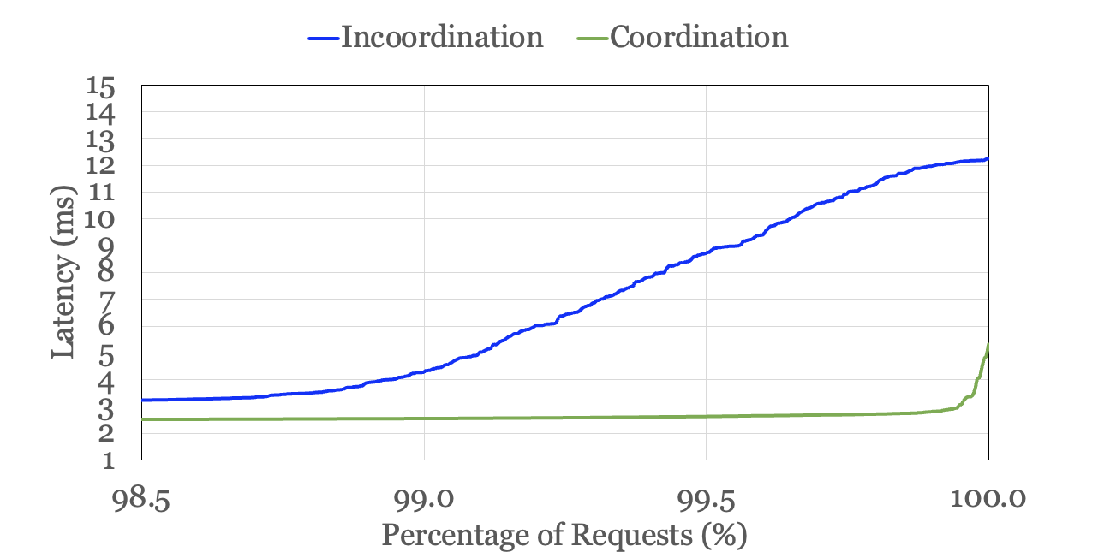
Network/Storage Co-Design is Promising
GC increases request tail latency by over 5x!
Requests spend nearly equal time in network and storage!
COMPUTER SCIENCE
Systems Platform Research Group at UIUC

Slide 50
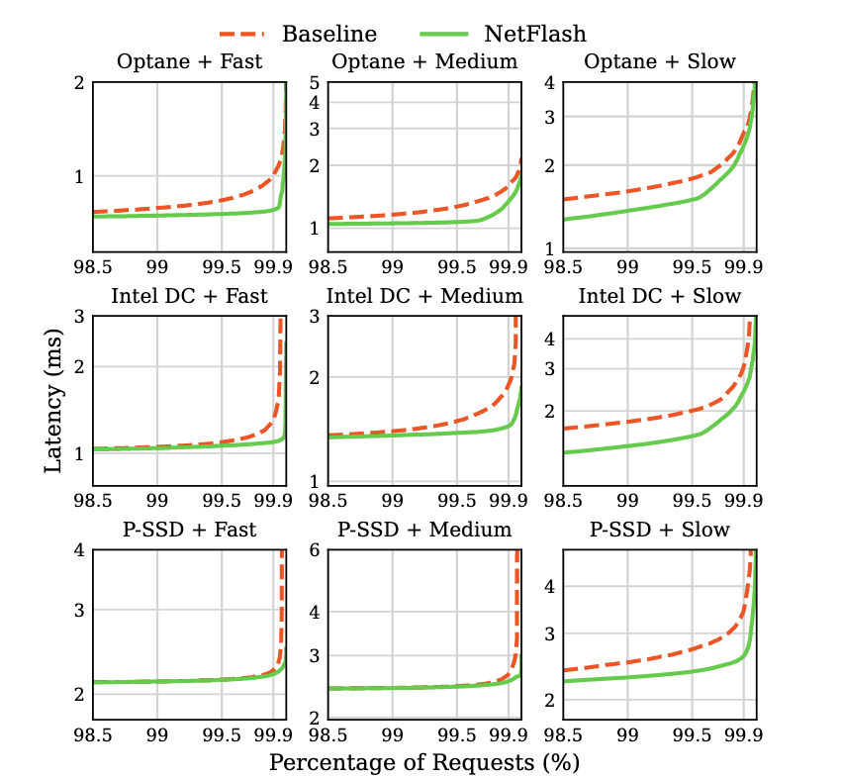
Sensitivity Study of Network/Storage Latency
Best improvement when variation and latencies match!
COMPUTER SCIENCE
Systems Platform Research Group at UIUC
Notes:
The diagonal has the best performance.

Slide 51
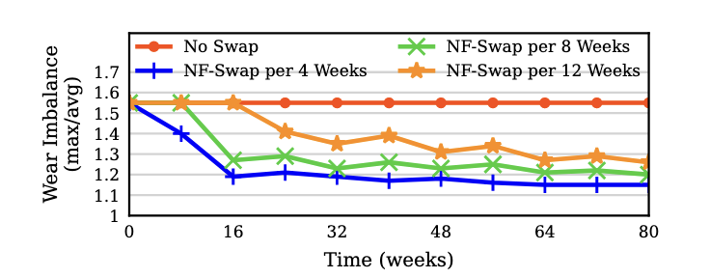
Coordinated Wear-Leveling
RackBlox ensures rack-scale wear-balance!
COMPUTER SCIENCE
Systems Platform Research Group at UIUC
Notes:
8 week default gives roughly 1.2x imbalance.

Slide 52
Improving End-To-End Performance
RackBlox reduces tail latency by up to 4.8x!
Systems Platform Research Group at UIUC
Notes:
**TODO switch this to RackBlox.
We breakdown the performance of RackBlox and compare against (1) VDC which provides software based token-bucket rate limiting per I/O Flow enforced for both network and storage at the end-hosts. Next, we compare with RackBlox with only I/O scheduling enabled. Finally, we show the performance of RackBlox. We see that coordinated I/O scheduling can outperform and achieves 1.4x speedup on average. However, with higher write rates, we have more intensive GC and therefore coordinated GC is necessary, resulting in nearly 5x speedup.

Slide 53
Flexibility for Supporting Different Storage Schedulers
Coordinated I/O Scheduling always outperforms incoordination!
Systems Platform Research Group at UIUC
Notes:
**TODO switch this to RackBlox.
To demonstrate the flexibility, we isolate the benefits of coordinated I/O scheduling when integrating it into different schedulers that Linux offers today, base FIFO (or no-op), deadline, and Kyber, which have different methods of targeting low latency storage requests. We see that coordination improves each one scheduler significantly achieving 1.4x improvements on average across different read/write ratios.

Slide 54
Filler
COMPUTER SCIENCE
Systems Platform Research Group at UIUC

